Slide 1
CakePHP
A PHP Framework

Slide 2
CakePHP
A framework for developing applications in PHP
Inspired by Ruby on Rails
Follows MVC design pattern
Convention over configuration
  No wheel reinventing required!

Slide 3
MVC
Model
  Data layer
View
  Presentation layer
Controller
  Logic layer

Slide 4
CakePHP Framework
app/
  config/
  controllers/
  models/
  plugins/
  tmp/
  vendors/
  views/
  webroot/
cake/
  config/
  docs/
  libs/
vendors/

Slide 5
Naming conventions
http://book.cakephp.org/view/328/Cake-Conventions
Table names: “notes”, “my_notes”
Model: “mynote.php”->“MyNote”
Controller: “my_notes_controller.php”-> “MyNotesController”
Views named after actions, organised in folders according to the related controller:
  views/my_notes/index.thtml
  views/my_notes/add.thtml

Slide 6
Paths + parameters
Cake uses url to pass parameters
Apache mod_rewrite converts url into scriptname and parameters
http://www.example.com /controllername/action/param1/param2/…
Uses paths to figure out views
Views stored in “controllername” folder

Slide 7
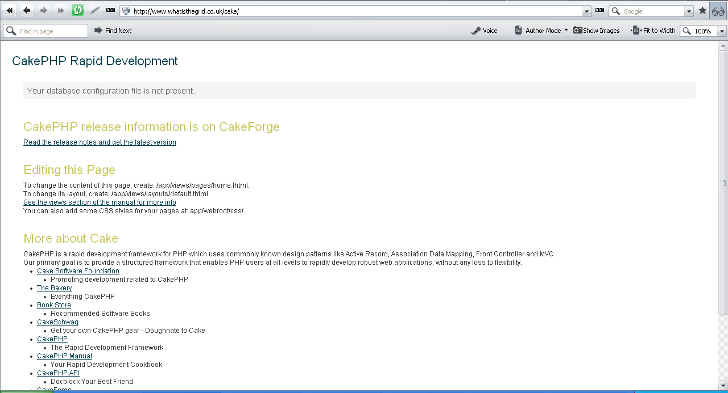


Slide 8
OOP in PHP
Limited support in PHP <5
Much better support in PHP >=5
Simpler than Java OOP
class SomeClass {
  function func() {
  ….
  }
  }
  SomeClass s = new someClass();
  s->func();

Slide 9
Hello world… again
Remember application is separated into model / view / controller
Model:
<?php
/* /app/model/hello.php */
class Hello extends AppModel {
var $name = 'Hello';
var $useTable = false;
}
?>

Slide 10
Hello world… again
View:
<!--
/* /app/views/index.thtml */
-->
<hr size=1/>
<h1><?php echo $data ?></h1>
<hr size=1/>

Slide 11
Controller:
<?php
/* app/controller/hello_controller.php */
class HelloController extends AppController {
var $name = "Hello";
var $uses = 'Hello';
function index() {
$data = 'Hello world!';
$this->set('data', $data);
}
}
?>

Slide 12
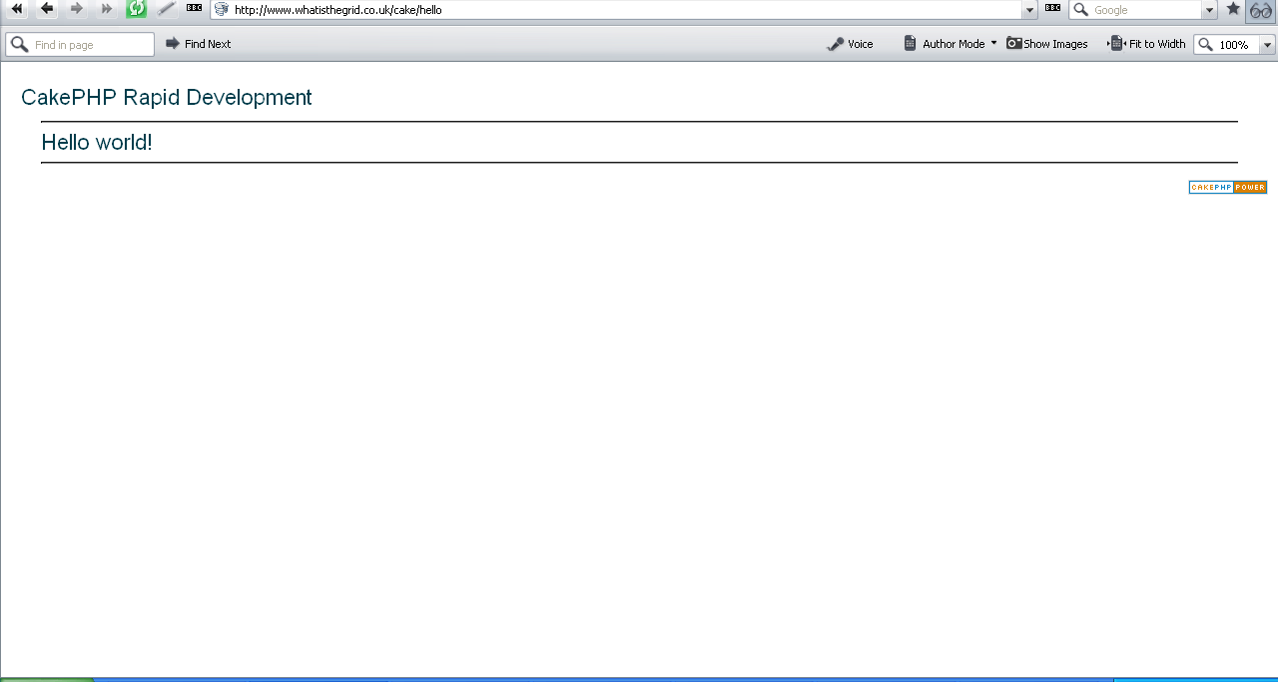

Slide 13
Simple DB table app
An online contact list
We want to add, edit, view and delete names and phone numbers
Uses a single table

Slide 14
Model
Add table to DB:
CREATE TABLE cake_contacts (
id INT UNSIGNED AUTO_INCREMENT PRIMARY KEY,
name VARCHAR(50),
number VARCHAR(50),
created DATETIME DEFAULT NULL,
modified DATETIME DEFAULT NULL
);

Slide 15
Model
Add a script called contact.php to models/
<?php
class Contact extends AppModel
{
var $name = ‘Contact';
}
?>

Slide 16
View
views/contacts/index.thtml
  <h1>Contact list</h1>
  <p>
  <?php echo $html->link('Add Contact', 'contacts/add') ?>
  </p>
  <table>
  <tr>
  <th>Id</th>
  <th>Name</th>
  <th>Number</th>
  </tr>

Slide 17
View
views/contacts/index.thtml cntd…
  <?php foreach ($contacts as $contact): ?>
  <tr>
  <td><?php echo $contact['Contact']['id']; ?></td>
  <td>
  <?php
  echo $html->link($contact['Contact'][name'],
  "contacts/view/{$contact['Contact']['id']}")?>
  [<?php echo $html->link('Edit',
  "contacts/edit/{$contact['Contact']['id']}")?>,
  <?php echo $html->link('Delete',
  "contacts/delete/{$contact['Contact']['id']}",
  null, 'Sure?')?>]
  </td>
  <td><?php echo $contact['Contact']['created']; ?>
  </td>
  </tr>
  <?php endforeach; ?>
  </table>

Slide 18
View
views/contacts/view.thtml
  <h1><?php echo $data['Contact']['name']?></h1>
  <p><small>
  Created: <?php echo $data['Contact']['created']?>
  </small></p>
  <p><?php echo $data['Contact']['number']?></p>

Slide 19
View
views/contacts/add.thtml
  <h1>Add Contact</h1>
  <form action="<?php echo $html->url("contacts/add"); ?>" method="post">
  <p>Name:
  <?php echo $html->input('Contact/name', array('size' => '40')) ?>
  </p>
  <p>Number:
  <?php echo $html->input('Contact/number', array('size' => '40')) ?>
  </p>
  <p><?php echo $html->submit('Save') ?>
  </p>
  </form>

Slide 20
View
views/contacts/edit.thtml
  <h1>Edit Contact</h1>
  <form action="<?php echo $html->url('/contacts/edit')?>" method="post">
  <?php echo $html->hidden('Contact/id'); ?>
  <p>Name:
  <?php echo $html->input('Contact/name',
  array('size' => '40')) ?>
  </p>
  <p>Number:
  <?php echo $html->input('Contact/number',
  array('size' => '40')) ?>
  </p>
  <p>
  <?php echo $html->submit('Save') ?>
  </p>
  </form>

Slide 21
Controller
/app/controllers/notes_controller.php:
<?php
class ContactsController extends AppController
{
var $name = 'Contacts';
function index() {
$this->set('contacts', $this->Contact->findAll());
}
function view($id) {
$this->Contact->id = $id;
$this->set('data', $this->Contact->read());
}

Slide 22
Controller
/app/controllers/notes_controller.php:
function add() {
if (!empty($this->data['Contact'])) {
if($this->Contact->save($this->data['Contact'])) {
$this->flash('Your contact has been added.',
‘/contacts/');
}
}
}
function delete($id) {
if ($this->Contact->del($id)) {
$this->flash('The contact with id: '.$id.' has been deleted.', ‘/contacts/');
}
}

Slide 23
Controller
/app/controllers/notes_controller.php:
function edit($id = null) {
if (empty($this->data['Contact'])) {
$this->Contact->id = $id;
$this->data = $this->Contact->read();
} else {
if($this->Contact->save($this->data['Contact'])) {
$this->flash('Your contact has been updated.',‘/contacts/');
}
}
}
}
?>

Slide 24
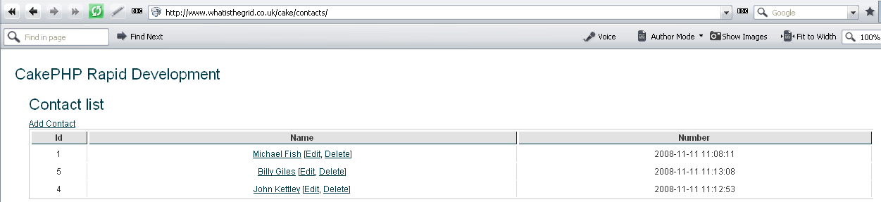
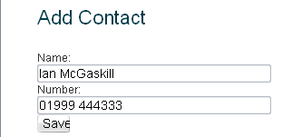

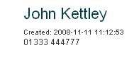
Resulting application
…../cake/contacts/add
…../cake/contacts/edit/1
…../cake/contacts/view/4

Slide 25
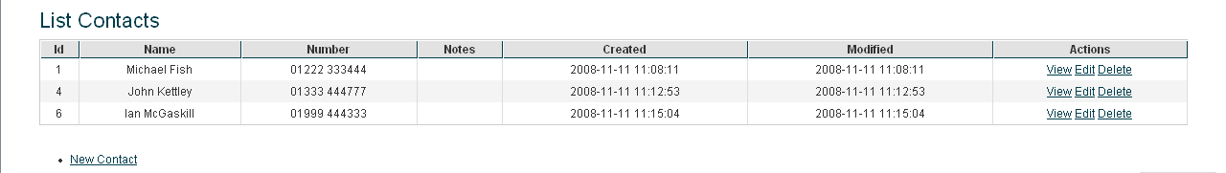
Other benefits
Bake script – command line script generator
Uses LAMP common web platform
  (Linux, Apache, MySQL and PHP)
Helpers for HTML, Forms, Pagination, AJAX, Javascript, XML, RSS
Scaffolding (no need for views)
  Create controller with var $scaffold;

Slide 26
Disadvantages
Mainly due to the limitations of PHP
  Clumsy OOP
  Access data through arrays not classes (which RoR does) – more code in view
Create tables in separate SQL
Not well documented yet

Slide 27
Baking
Right click on "My Computer" and select "properties” Select the "Advanced Tab"
Click the "Environment Variables" button at the bottom Under the "System Variables" list find the "Path" variable and click "edit"
Now add the full path of your Php directory in your server e.g. ";C:\server\php" separated by a comma.

Slide 28
Baking…
Open the windows command prompt (Start -> Run -> type "cmd" then click 'ok')
Navigate to the "Bake" script location by typing "cd C:\server\htdocs\cakephp\cake\scripts"
Run the "Bake" Script by typing "php bake.php"

Slide 29
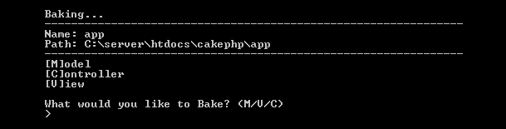
Baking…

Slide 30
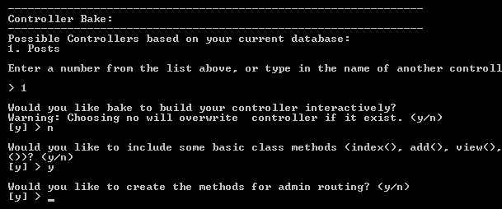
Baking…

Slide 31
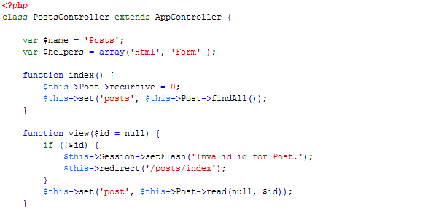
Baking…

Slide 32
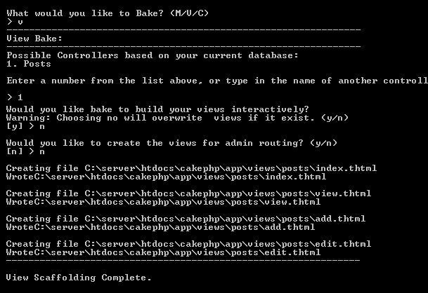
Baking…

Slide 33
Cheat Sheet
CakePHP Naming Conventions
  CakePHP Models
    class names are singular
    class names UpperCamelCased
    filenames use a lower-case underscored syntax
    database tables are plural underscored
    set var $name in your model definition (PHP4)

Slide 34
Cheat Sheet...
CakePHP Naming Conventions
  CakePHP Controllers
    class names are plural
    class names are UpperCamelCased for multi-word controllers
    class names also end with 'Controller'
    file names use a lower-case underscored syntax
    file names also end with '_controller.php'.

Slide 35
Cheat Sheet...
CakePHP Naming Conventions
  CakePHP Views
    views are in folders that match controller
    view folders are plural underscored
    views are named after actions they display.
    name the view file after action name, in lowercase.

Slide 36
Cheat Sheet...
CakePHP naming conventions – Examples
  Assuming we have a database table named orders, the following standard CakePHP naming conventions should be used:
Model
  filename = order.php
  classname = Order
  directory = app/models
View
  filename = (same as the action name in the controller)
  extension = .ctp (the filename extension)
  directory = app/views/orders
Controller
  filename = orders_controller.php
  classname = OrdersController
  directory = app/controllers

Slide 37
Cheat Sheet...
CakePHP naming conventions – Examples...
  Assuming we have a database table named order_items, the following standard CakePHP naming conventions should be used:
Model
  filename = order_item.php
  classname = OrderItem
  directory = app/models
View
  filename = (same as the action name in the controller)
  extension = .ctp (the filename extension)
  directory = app/views/order_items
Controller
  filename = order_items_controller.php
  classname = OrderItemsController
  directory = app/controllers

Slide 38
Cheat Sheet...
Bake Commands
  cake bake
  cake bake controller
  cake bake model
  cake bake view
  cake bake project
  cake bake controller orders
  cake bake model order

Slide 39
Cheat Sheet...
CakePHP Foreign Key Examples and Relationship Types
Relationship | Association | Type Example
one to one | hasOne | A user has one profile.
one to many | hasMany | A user can have multiple recipes.
many to one | belongsTo | Many recipes belong to a user.
many to many | hasAndBelongsToMany | Recipes have, and belong to many tags.

Slide 40
Cheat Sheet...
relationship type examples
  # in a Post model class:
  # each Post belongs to a User
  var $belongsTo = array('User');
  # TODO
  var $hasOne ...
  # in the User model
  var $hasMany = array('Post');
  # TODO
  var $hasAndBelongsToMany

Slide 41
Cheat Sheet...
The CakePHP recursive attribute
Value | Meaning
-1 | returns only the current model, and ignores all associations.
0 | returns the current model, plus its owner(s).
1 | returns the current model, its owner(s), plus their associated models.
2 | returns the current model, its owner(s), their associated models, and the associated models of any associations.
function index() {
$this->Post->recursive = 0;
$this->set('posts', $this->paginate); }

Slide 42
Cheat Sheet...
find query parameters
  Type
    'first‘
    can be 'all', 'first', or 'list'. determines what type of find operation to perform. (TODO - more info here)
  Conditions
    array containing the find (select) conditions as key/value pairs
  Fields
    array specifying which fields should be retrieved in the resulting select query
  order
    sql 'order by conditions. field name must be followed by ASC or DESC
  page
    page number, used for paged data

Slide 43
Cheat Sheet...
find query parameters...
  limit
    a limit on the number of results returned, like 'select * from orders limit 20'.
  offset
    sql offset value (i haven't used this query much myself, but i think it refers to skipping X number of rows returned in a query)
  recursive
    the cakephp recursive value, relating to associated model data

Slide 44
Cheat Sheet...
find query Examples...
  $this->Post->find('all');
    Simple Enough?
  $this->Post->find('all', array('conditions'=>array('User.id'=>5)));
    A CakePHP find query with one condition:
  $this->Post->find('all', array('conditions'=>array('User.id'=>'<> 5')));
    A CakePHP find query with one "not equal to" condition:

Slide 45
Cheat Sheet...
find query Examples...
  $this->Post->find('all', array('conditions'=>array('User.id'=>1, 'Post.id'=>'> 50')));
    A CakePHP find query with multiple conditions:
  $this->Post->find('all', array('conditions'=>array('User.id'=>5), 'fields'=>'Post.name', 'order'=>'Post.id ASC', 'limit'=>20, 'recursive'=>0));
    A CakePHP find query that uses all the find function parameters:

Slide 46
Cheat Sheet...
Order by Examples
  array('order'=>'date ASC')
  array('order'=>'date DESC')
  array('order'=>'User.id DESC')

Slide 47
Cheat Sheet...
other CakePHP find query examples:
  $this->Order->find('all');
  $this->Order->find(null, null, 'date DESC');
  $this->Order->find('all', array('conditions'=>array('User.id'=>1)));
  $this->Order->find('all', array('conditions'=>array('User.id'=>array(1,2,3,4))));
  $this->Order->find('all', array('conditions'=>array('User.id'=>'<> 1')));
  $this->Order->find('all', array('conditions'=>array('User.id'=>1, 'DATE(Post.date)'=>'CURDATE()')));
  $this->Order->find('all', array('order'=>'date ASC', 'limit'=>20, 'recursive'=>0);

Slide 48
Cheat Sheet...
Many More Scanerios from http://book.cakephp.org/view/1017/Retrieving-Your-Data
  find threaded
  find neighbors
  findAllBy
  findBy
  query
  field
  read

Slide 49
Cheat Sheet...
CakePHP logging
  CakeLog::write('debug', 'Something did not work');
  $this->log("Something did not work!", 'debug');
  Configure::write('log', E_WARNING);

Slide 50
Cheat Sheet...
CakePHP controller properties:
  $name = null
  $action = null
  $autoLayout = true
  $autoRender = true
  $base = null
  $beforeFilter = null
  $cacheAction = false
  $components = array()
  $data = array()
  $helpers = array('Html')

Slide 51
Cheat Sheet...
  $here = null
  $layout = 'default'
  $output = null
  $pageTitle = false
  $params = array()
  $persistModel = false
  $plugin = null
  $uses = false
  $view = 'View'
  $viewPath = null
  $webroot = null
  $_viewClass = null
  $_viewVars = array()

Slide 52
Cheat Sheet...
CakePHP Data Validation
<?php
class User extends AppModel {
var $name = 'User';
var $validate = array( 'login' => 'alphaNumeric', 'email' => 'email', 'born' => 'date' );
} ?>

Slide 53
Cheat Sheet...
CakePHP controller callbacks
  afterFilter ()
  beforeFilter ()
  beforeRender ()

Slide 54
Cheat Sheet...
CakePHP Model callbacks
  afterDelete ()
  afterFind ($results)
  afterSave ()
  beforeDelete ()
  beforeFind (&$queryData)
  beforeSave ()
  beforeValidate ()

Slide 55
Cheat Sheet...
CakePHP Helpers
  Html Helper
  Form Helper
  Ajax Helper
  Text Helper
  Time Helper
  Number Helper

Slide 56
Cheat Sheet...
CakePHP Components
  Session Component
  RequestHandler Component
  Security Component
  ACL Component

Slide 57
Cheat Sheet...

Slide 58
Cheat Sheet...

Slide 59
Cheat Sheet...

Slide 60
Cheat Sheet...

Slide 61
Cheat Sheet...

Slide 62
Cheat Sheet...

Slide 63
Cheat Sheet...

Slide 64
Cheat Sheet...

Slide 65
Cheat Sheet...

